Slide 1

Neural Machine Translation
Submitted by:-
Nitish Kumar Jha(02151202819) Vivek Dubey (01951202819)
Shilpa Gautam(02551202818)

Slide 2
Introduction
“If you talk to a man in a language he understands, that goes to his head. If you talk to him in his own language, that goes to his heart.” – Nelson Mandela.
The beauty of language transcends boundaries and cultures. Learning a language other than our mother tongue is a huge advantage. But the path to bilingualism, or multilingualism, can often be a long, never-ending one.
There are so many little nuances that we get lost in the sea of words. Things have, however, become so much easier with online translation services (I’m looking at you Google Translate!).

Slide 3
Machine Translation – A Brief History
Most of us were introduced to machine translation when Google came up with the service. But the concept has been around since the middle of last century.
Research work in Machine Translation (MT) started as early as 1950’s, primarily in the United States. These early systems relied on huge bilingual dictionaries, hand-coded rules, and universal principles underlying natural language.
In 1954, IBM held a first ever public demonstration of a machine translation. The system had a pretty small vocabulary of only 250 words and it could translate only 49 hand-picked Russian sentences to English. The number seems minuscule now but the system is widely regarded as an important milestone in the progress of machine translation.

Slide 4
Soon, two schools of thought emerged:
Empirical trial-and-error approaches, using statistical methods, and
Theoretical approaches involving fundamental linguistic research
In 1964, the Automatic Language Processing Advisory Committee (ALPAC) was established by the United States government to evaluate the progress in Machine Translation. ALPAC did a little prodding around and published a report in November 1966 on the state of MT. Below are the key highlights from that report:
It raised serious questions on the feasibility of machine translation and termed it hopeless
Funding was discouraged for MT research
It was quite a depressing report for the researchers working in this field
Most of them left the field and started new careers.
Not exactly a glowing recommendation!

Slide 5
Understanding the Problem Statement
The objective is to convert a English sentence to its french counterpart using a Neural Machine Translation (NMT) system.

Slide 6
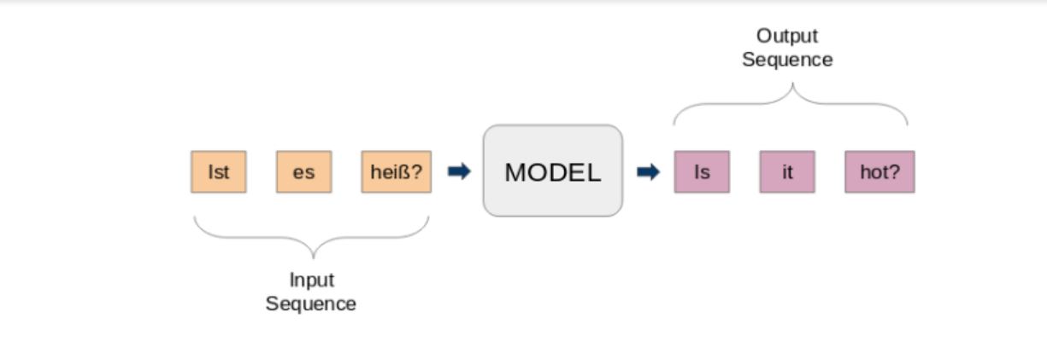
Introduction to Sequence-to-Sequence (Seq2Seq) Modeling
Sequence-to-Sequence (seq2seq) models are used for a variety of NLP tasks, such as text summarization, speech recognition, DNA sequence modeling, among others. Our aim is to translate given sentences from one language to another.
Here, both the input and output are sentences. In other words, these sentences are a sequence of words going in and out of a model. This is the basic idea of Sequence-to-Sequence modeling. The figure below tries to explain this method.

Slide 7
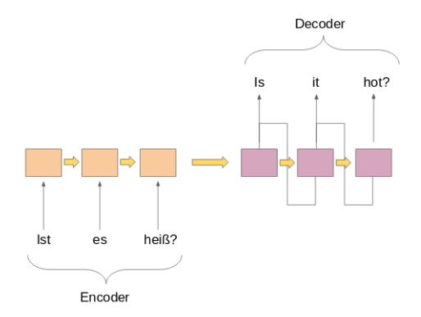
A typical seq2seq model has 2 major components –
a) an encoder b) a decoder
Both these parts are essentially two different recurrent neural network (RNN) models combined into one giant network:

Slide 8
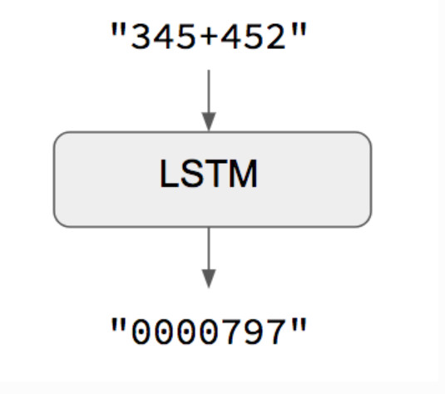
The trivial case: when input and output sequences have the same length
When both input sequences and output sequences have the same length, you can implement such models simply with a Keras LSTM or GRU layer (or stack thereof). This is the case in this example script that shows how to teach a RNN to learn to add numbers, encoded as character strings:

Slide 9
The general case: canonical sequence-to-sequence
In the general case, input sequences and output sequences have different lengths (e.g. machine translation) and the entire input sequence is required in order to start predicting the target. This requires a more advanced setup, which is what people commonly refer to when mentioning "sequence to sequence models" with no further context. Here's how it works:
A RNN layer (or stack thereof) acts as "encoder": it processes the input sequence and returns its own internal state. Note that we discard the outputs of the encoder RNN, only recovering the state. This state will serve as the "context", or "conditioning", of the decoder in the next step.
Another RNN layer (or stack thereof) acts as "decoder": it is trained to predict the next characters of the target sequence, given previous characters of the target sequence.

